Slide 1
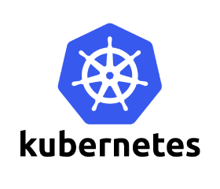















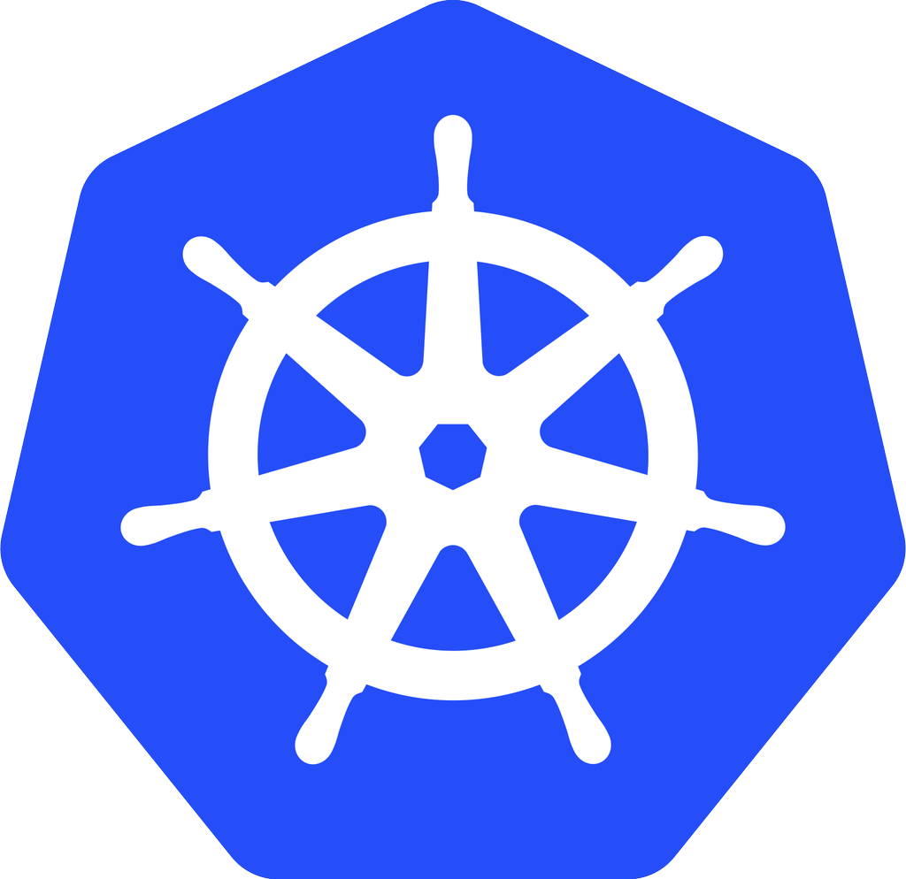







Microservices, Kubernetes & Istio - A great fit!
ISTIO CONTROL
ISTIO
DATA
PLANE
PLANE
SAMPLE BOOKINFO APP
ENVOY
ISTIO PILOT
ENVOY
50%
REVIEWS-V1
ENVOY
MIXER
ENVOY
REVIEWS-V2
ENVOY
r
RATINGS
BOOK PAGE
USER
ENVOY
REVIEWS-V3
50%
ISTIO AUTH
ENVOY
r
DETAILS

Slide 2

Microservices
An engineering approach focused on decomposing an application into single-function modules with well defined interfaces which are independently deployed and operated by a small team who owns the entire lifecycle of the service.
Microservices accelerate delivery by minimizing communication and coordination between people while reducing the scope and risk of change.

Slide 3
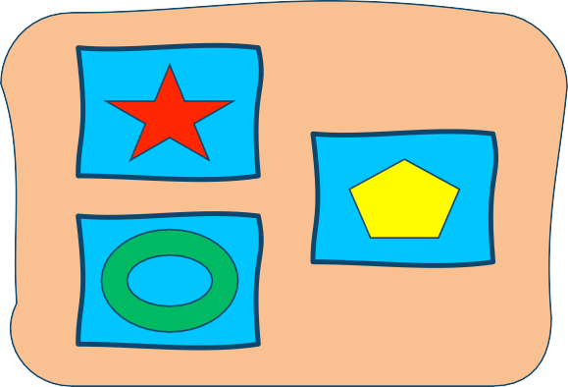
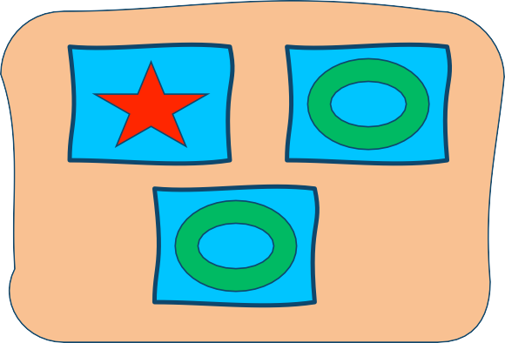
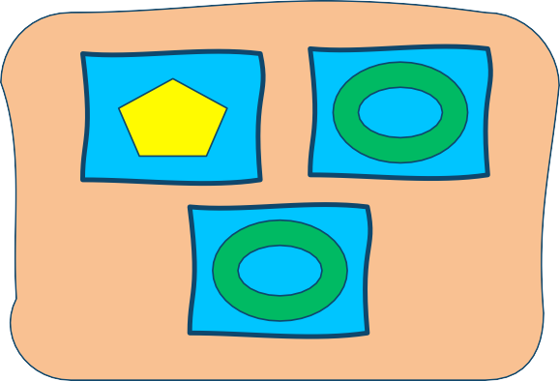
Microservices Application
Scaling

Slide 4
Microservices Application
Update

Slide 5


IBM Bluemix Container Service
Typically microservices are encapsulated inside containers…
One:One relationship between a microservice and a container Everyone’s container journey starts with one container….

Slide 6
At first the growth is easy to handle….
IBM Bluemix Container Service

Slide 7



But soon it is overwhelming…we need container and microservices management
IBM Bluemix Container Service

Slide 8








IBM Bluemix Container Service
 | Enter Container Orchestrator

Slide 9


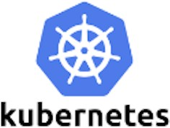


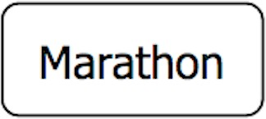
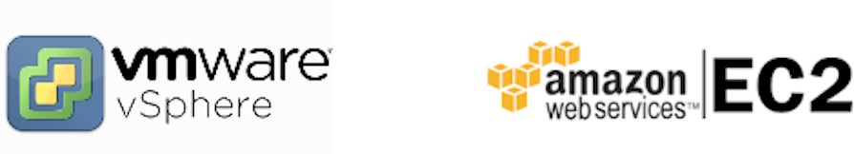
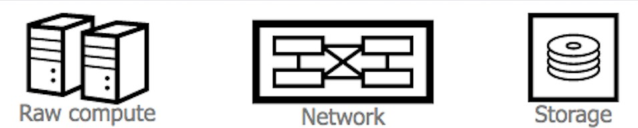
Container Stack
Slide Title Goes Here
Layer 6
Development Workflow Opinionated Containers
Layer 5
Orchestration/Scheduling Service Model
Layer 4
Container Engine
Layer 3
Operating System
Layer 2
Virtual Infrastructure
Layer 1
Physical Infrastructure

Slide 10
Kubernetes

Slide 11
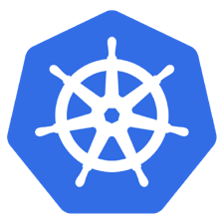
What is Kubernetes?
Slide Title Goes Here
Container orchestrator
Runs and manages containers
Supports multiple cloud and bare-metal environments
Inspired and informed by Google's experiences and internal systems
100% Open source, written in Go
Manage applications, not machines
Rich ecosystem of plug-ins for scheduling, storage, networking

Slide 12
Kubernetes Architecture
Slide Title Goes Here
Kubernetes Master |  | Worker Node 1
 | Worker Node 2
 |  | Worker Node 3
 |  | Worker Node n
Registry
UI
API
CLI
Etcd
API Server
Controller Manager Server
Scheduler Server

Slide 13



Kubernetes Architecture
Slide Title Goes Here
Nodes – hosts that run Kubernetes applications
Worker Node 1
UI
Worker Node 2
Kubernetes
^{API} Master
Worker Node 3
CLI Worker Node n
Registry
• Etcd
• API Server
• Controller Manager Server
• Scheduler Server
Worker nodes:
Hosts the K8s services
Kubelet (K8s agent that accepts commands from the master)
Master nodes:
Kubeproxy (network proxy service
Controls and manages the cluster
Kubectl (command line)
REST API (communication with workers)
Scheduling and replication logic
responsible for routing activities for
inbound or ingress traffic)
Docker host

Slide 14




Kubernetes Architecture
Slide Title Goes Here
Labels:
Pods:
Worker Node 1
UI
Worker Node 2
Kubernetes
^{API} Master
Worker Node 3
CLI Worker Node n
Registry
• Etcd
• API Server
• Controller Manager Server
• Scheduler Server
Smallest deployment unit in K8s
Collection of containers that run on a
Metadata assigned to K8s resources
worker node
Key-value pairs for identification
Critical to K8s as it relies on querying the
Each has its own IP
Pod shares a PID namespace,
cluster for resources that have certain labels
network, and hostname
Replication controller:
Service:
Ensures availability and scalability
Maintains the number of pods as requested by
Collections of pods exposed as an
endpoint
user
Uses a template that describes specifically what each pod should contain
Information stored in the K8s cluster state and networking info propagated to all worker nodes

Slide 15
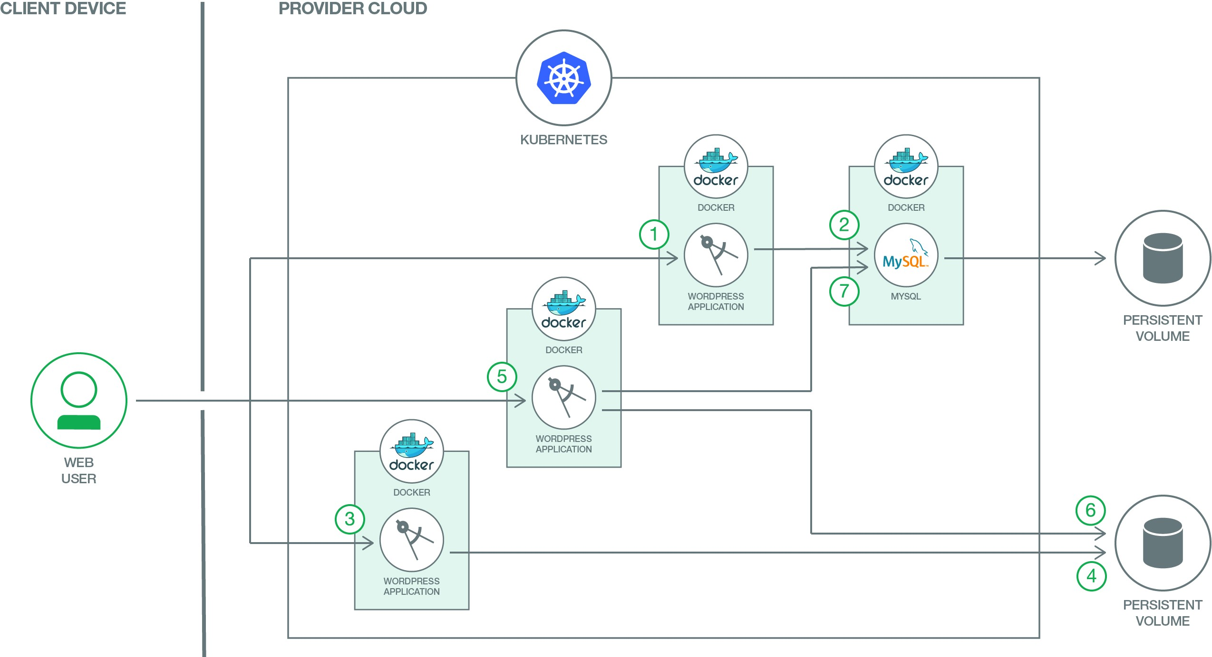
Developer Journeys:
Scalable Wordpress on Kubernetes
Slide Title Goes Here
In addition to running MySQL inside a container, we also show advanced capabilities like Bluemix service binding by leveraging Compose for MySQL service
Developer Works Code: https://developer.ibm.com/code/journey/scalable-wordpress-on-kubernetes Github: https://github.com/IBM/scalable-wordpress-deployment-on-kubernetes

Slide 16
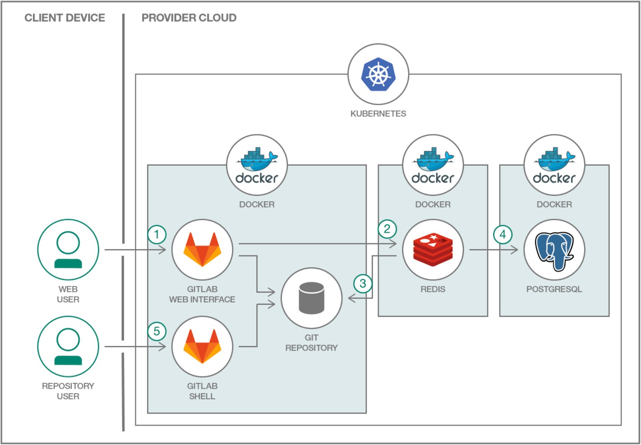
Developer Journeys:
Deploy a Distributed GitLab on Kubernetes
Slide Title Goes Here
This project shows how a common multi-component application can be deployed. GitLab represents a typical multi-tier app and each component will have their own container(s).
Developer Works Code: https://developer.ibm.com/code/journey/run-gitlab-kubernetes/ Github: https://github.com/IBM/kubernetes-container-service-gitlab-sample

Slide 17
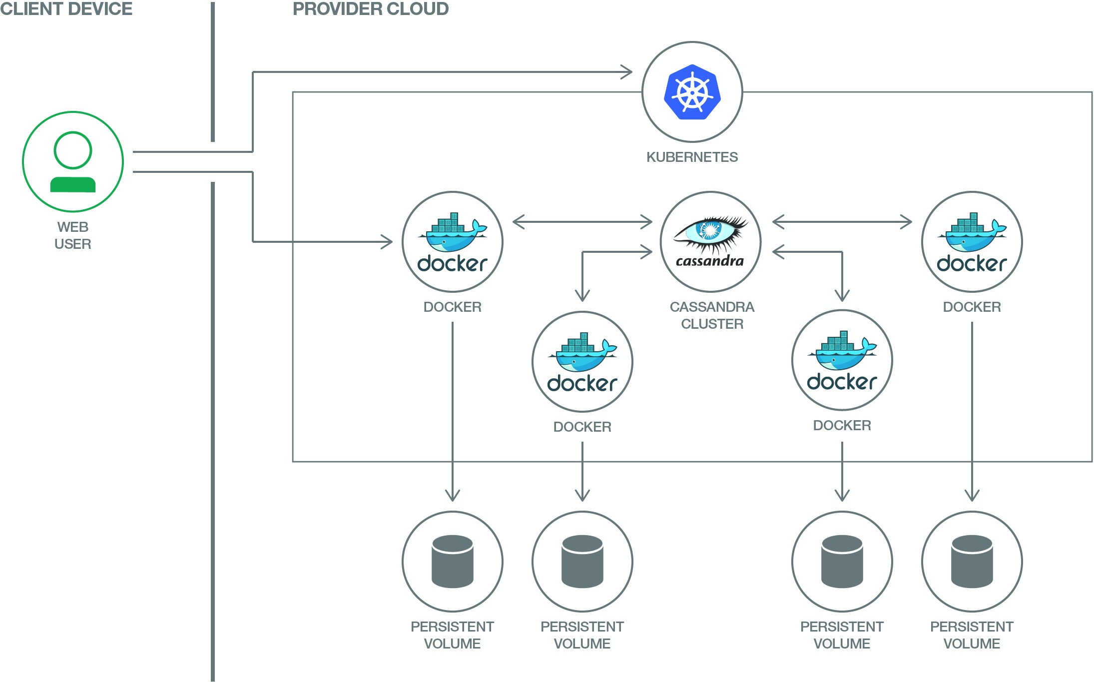
Developer Journeys:
Scalable Apache Cassandra on Kubernetes
Slide Title Goes Here
Leverages Kubernetes Pods, Service, Replication Controller, StatefulSets
Developer Works Code: https://developer.ibm.com/code/journey/deploy-a-scalable-apache-cassandra-database-on-kubernetes Github: https://github.com/IBM/scalable-cassandra-deployment-on-kubernetes

Slide 18
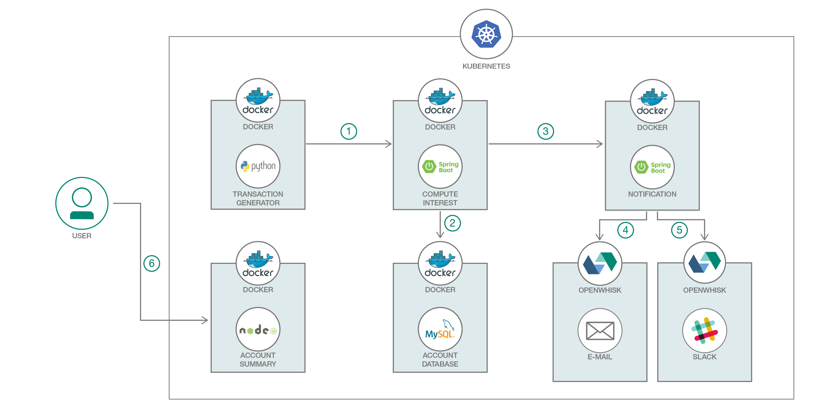
Developer Journeys:
Spring Boot Microservices on Kubernetes
Slide Title Goes Here
This journey shows you how to create and deploy Spring Boot microservices within a polyglot application and then deploy the app to a Kubernetes cluster.
Developer Works Code: https://developer.ibm.com/code/journey/deploy-spring-boot-microservices-on-kubernetes/ Github: https://github.com/IBM/spring-boot-microservices-on-kubernetes

Slide 19
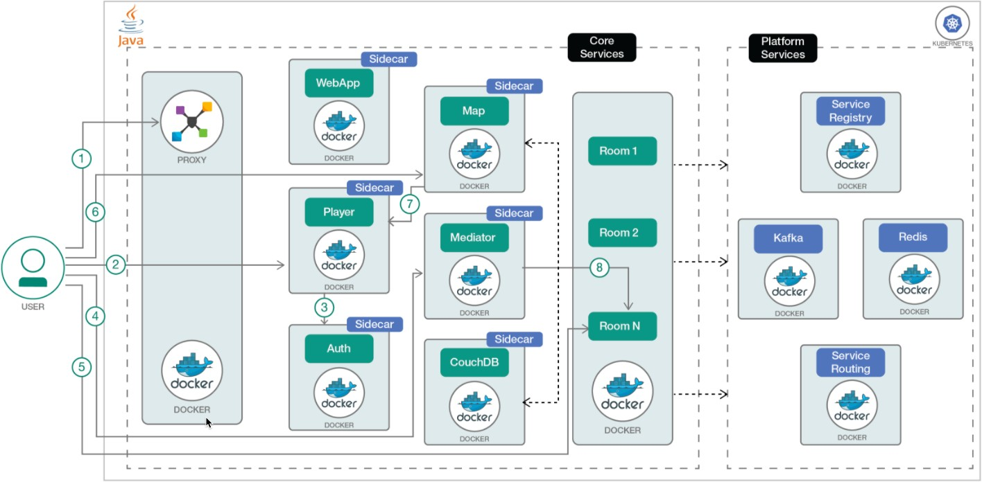
Developer Journeys:
Deploy Java microservices on Kubernetes within a polyglot ecosystem
Slide Title Goes Here
With current application architectures, microservices need to co-exist in polyglot environments. In this developer journey, you’ll learn how to deploy a Java microservices application that runs alongside other polyglot microservices, leveraging service discovery, registration, and routing.
Developer Works Code: https://developer.ibm.com/code/journeys/deploy-java-microservices-on-kubernetes-with-polyglot-support/ Github: https://github.com/IBM/GameOn-Java-Microservices-on-Kubernetes

Slide 20
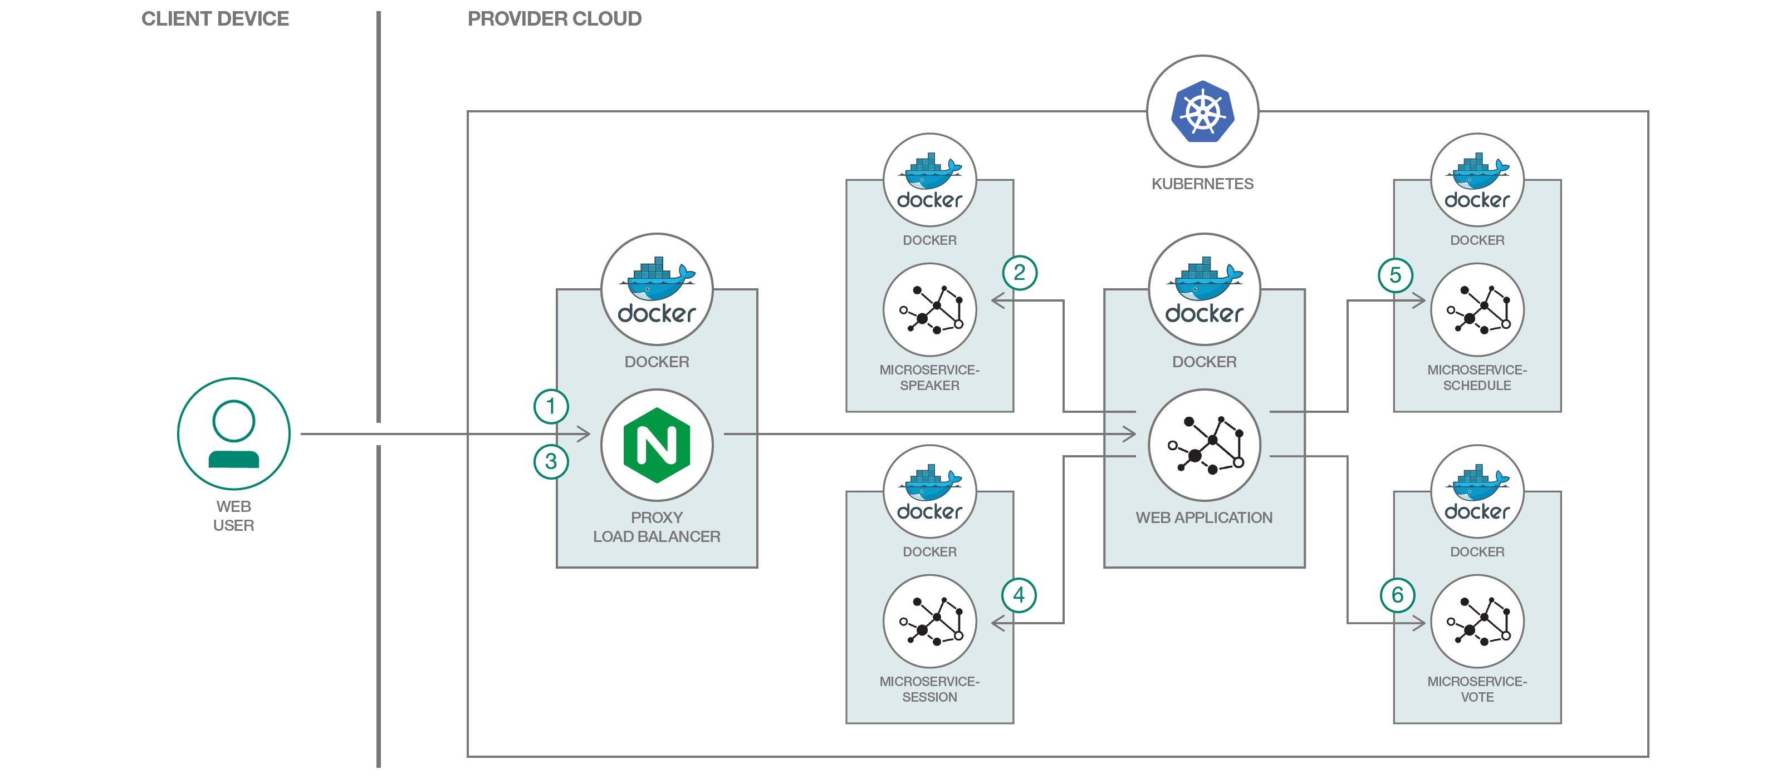
Developer Journeys:
Java MicroProfile Microservices on Kubernetes
Slide Title Goes Here
Java based Microservices application using MicroProfile (baseline for Java Microservices architecture) and Microservices Builder on Kubernetes
Developer Works Code: https://developer.ibm.com/code/journey/deploy-microprofile-java-microservices-on-kubernetes Github: https://github.com/IBM/java-microprofile-on-kubernetes

Slide 21
Kubernetes is great for Microservices…
Why do we need a Service mesh and what is it?

Slide 22

What else do we need for Microservices?
Visibility
Resiliency & Efficiency
Traffic Control
Security
Policy Enforcement
Enter Service Mesh

Slide 23





















Service Mesh Data Plane
Service Mesh Control Plane
How to build a ‘Service Mesh’ ?
Microservice-1
SERVICE DISCOVER Y
TELEMETR Y
Sidecar
Lightweight sidecars to manage traffic between services
Microservice-2
SERVICE REGISTRY
ACCESS CONTROL
Sidecar
Sidecars can do much more than just load balancing!
Microservice-3
ROUTING RULES
RESILIENC Y FEATURES
Sidecar

Slide 24
Istio

Slide 25













ISTIO CONTROL
ISTIO DATA
PLANE
PLANE
Pilot - Configures Istio deployments
and propagate configuration to the other components of the system.
Routing and resiliency rules go here
ENVOY
ISTIO PILOT
ROUTING RULES
ENVOY
MICROSERVICE
Mixer - Responsible for policy
decisions and aggregating telemetry data from the other components in the system using a flexible plugin architecture
ENVOY
MIXER
GRAPHANA
/ZIPKIN
MICROSERVICE
Istio Concepts
ENVOY
Proxy – Based on Envoy, mediates
inbound and outbound traffic for all Istio-managed services. It enforces access control and usage policies, and provides rich routing, load balancing, and protocol conversion.
MICROSERVICE
ISTIO AUTH
ENVOY
MICROSERVICE

Slide 26























ISTIO CONTROL
ISTIO DATA
PLANE
PLANE
SAMPLE BOOKINFO APP
ENVOY
ISTIO PILOT
ROUTING RULES
ENVOY
50%
REVIEWS-V1
ENVOY
MIXER
GRAPHANA
/ZIPKIN
ENVOY
REVIEWS-V2
ENVOY
BOOK PAGE
USER
RATINGS
Istio Concepts
ENVOY
REVIEWS-V3
50%
ISTIO AUTH
ENVOY
DETAILS

Slide 27
Control Plane REST API
Istio ingress Controller
Prometheus
Proxy
_{IsIst}Is_{itoi}t_{o}io_{CCo}C_{on}o_{nt}n_{rtor}t_{o}r_{l}o_{lP}l_{Pl}P_{alan}la_{ne}n_{e}e (Pilot, Mixer,Auth)
Metrics & reports from proxies
Kube API Server
2. Proxy implements intelligent L7 routing, circuit breakers, enforces policies and reports metrics to control plane.
Pod
Istio Architecture
Proxy
Proxy
1. All traffic entering and leaving pod is transparently routed via Proxy without requiring any application changes.
appA
appB
Service A
Service B
Kubernetes Cluster
Proxy. Based on Envoy, a high performance L7 proxy from Lyft, currently being used at large scale in production. https://github.com/lyft/envoy
Istio control plane traffic. Request routing rules, resilience configuration (circuit breakers, timeouts, retries), policies (ACLs, rate limits, auth), and metrics/reports from proxies.
User/application traffic. HTTP/ 1.1, HTTP/2, gRPC, TCP with or without TLS

Slide 28
Kubernetes, Microservices and Istio
Developer Journeys

Slide 29
What is a ‘Service Mesh’ ?
A network for services, not bytes
" Resiliency & Efficiency
Traffic Control
Visibility
Security
Policy Enforcement

Slide 30
Resiliency
Istio adds fault tolerance to your application without any changes to code
Resilience features
Timeouts
Retries with timeout budget
Circuit breakers
Health checks
AZ-aware load balancing w/ automatic failover
Control connection pool size and request load
Systematic fault injection
// Circuit breakers
destination: serviceB.example.cluster.local
policy:
- tags:
version: v1 circuitBreaker:
simpleCb: maxConnections: 100
httpMaxRequests: 1000
httpMaxRequestsPerConnection: 10
httpConsecutiveErrors: 7
sleepWindow: 15m httpDetectionInterval: 5m

Slide 31
Resiliency Testing
Systematic fault injection to identify weaknesses in failure recovery policies
HTTP/gRPC error codes
Delay injection
Timeout: 100ms Retries: 3 300ms
Timeout: 200ms Retries: 2 400ms
Envoy
Envoy
Envoy
svcA
svcB
svcC
Service A
Service B
Service C

Slide 32
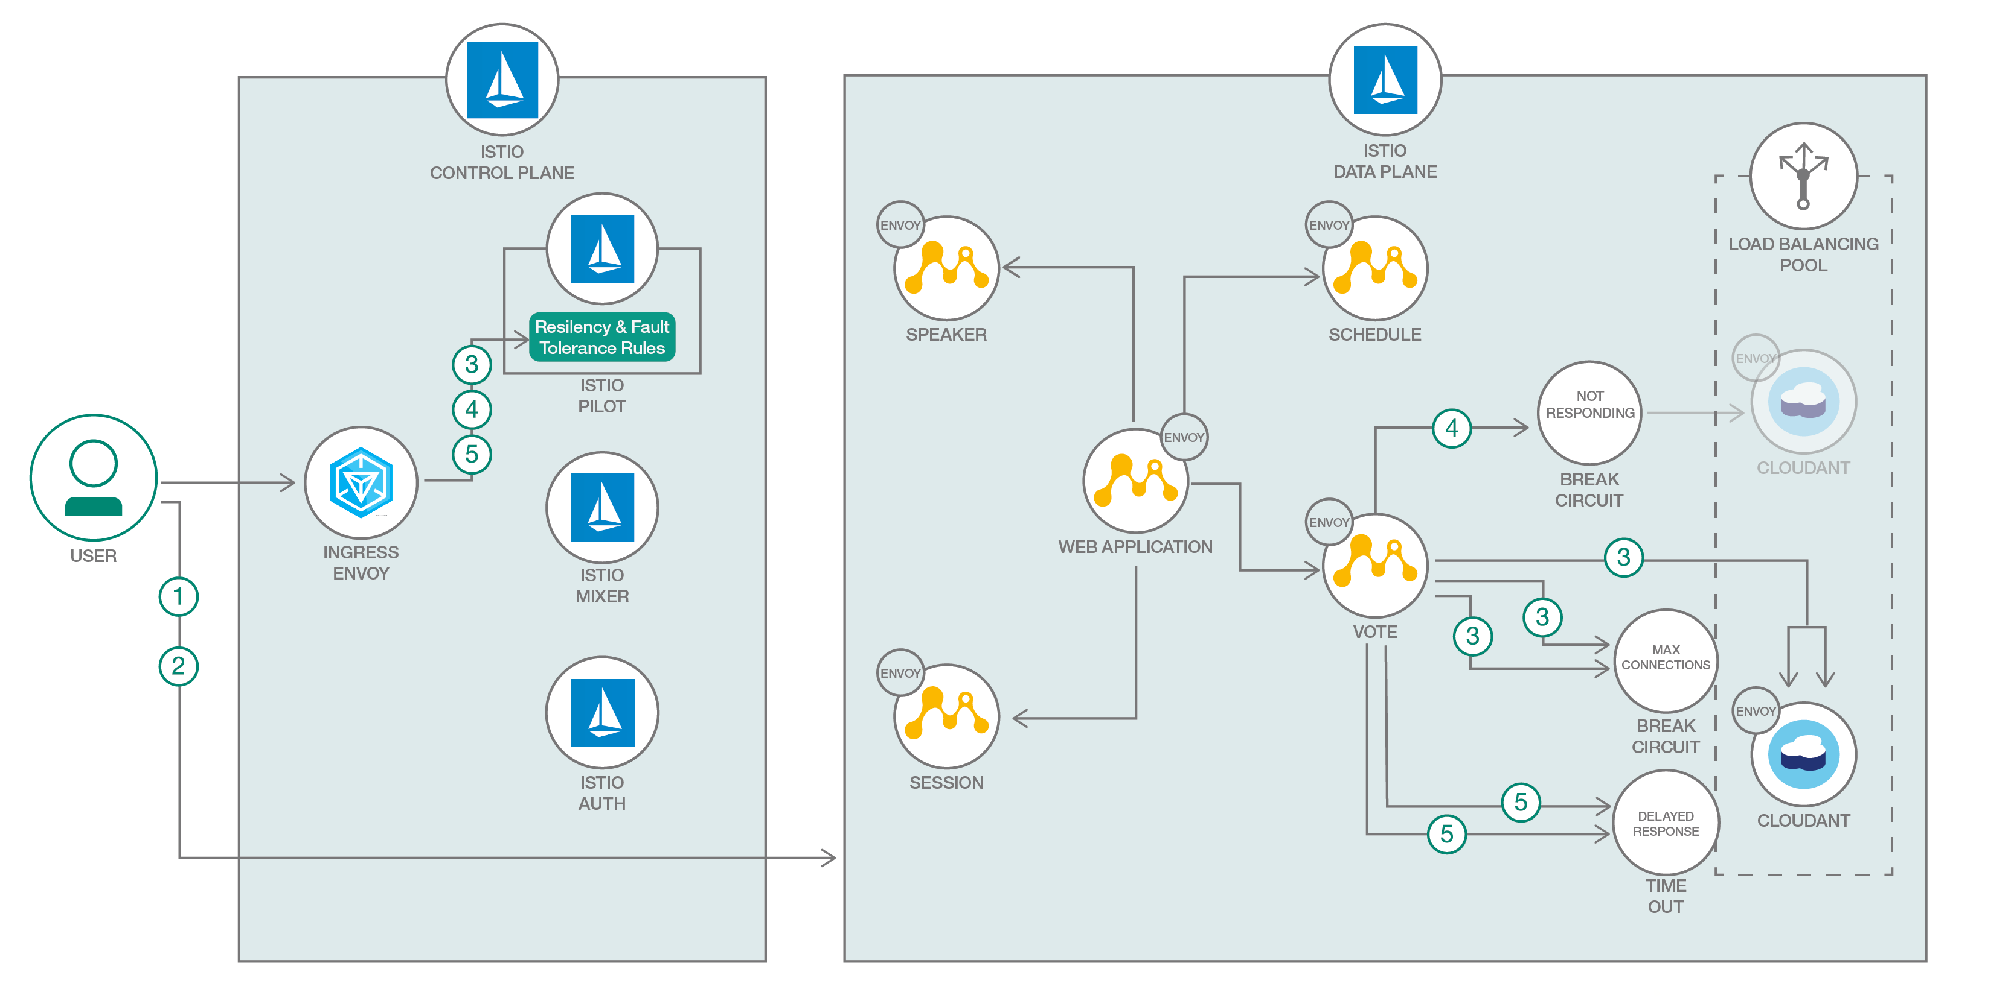
Developer Journey:
Leverage Istio to create resilient and fault tolerant Microservices
Slide Title Goes Here
Twelve-factor apps make a strong case for designing and implementing your microservices for failure. What that means is with the proliferation of microservices, failure is inevitable, and applications should be fault-tolerant. Istio, a service mesh, can help make your microservices resilient without changing application code.
Developer Works Code: https://developer.ibm.com/code/journey/make-java-microservices-resilient-with-istio/ Github: https://github.com/IBM/resilient-java-microservices-with-istio

Slide 33

































Resilient Microservices with Istio
ISTIO CONTROL
ISTIO DATA PLANE
PLANE
Load Balancing
ENVOY
ENVOY
speaker
schedule
Pool
ISTIO PILOT
ENVOY
ENVOY
3 4
RESILIENC Y & FAULT TOLERANC E RULES
5
ENVOY
web-application
NOT RSPONDING
- CIRCUIT BREAK
4
ENVOY
MIXER
3
ENVOY
vote
ENVOY
ISTIO AUTH
session
MAX
CONNECTIONS
- CIRCUIT BREAK
5
1
DELAYED RESPONSE
- TIME OUT
2

Slide 34




User Input
Istio Ingress
N requests
N requests
Envoy
MS-A
Reached maximum pending requests - eject all the incoming requests.
Administrator
Set Destination Policy
Reached maximum connections –
put the incoming requests in pending state
Circuit Breaker ( X Max Conn,
Y Max Pending)
Istio Pilot
Envoy
MS-B

Slide 35
User Input
Istio Ingress
N requests
N requests
Envoy
MS-A
1
2
3
Administrator
Set Destination Policy
Circuit Breaker
503
Envoy MS-B
Istio Pilot
Envoy
MS-B
MS-B Pod 2
(Broken)
MS-B Pod 1
(Working)
Eject X minutes
Load Balancing Pool for MS-B

Slide 36
504 error
User Input
Istio Ingress
N requests
N requests
Envoy
MS-A
Timeout
Administrator
Fault Injection
X seconds delay
Set Route Rule
Envoy MS-B
Istio Pilot
MS-B Pod

Slide 37
What is a ‘Service Mesh’ ?
A network for services, not bytes
Resiliency & Eﬃciency
Traﬃc Control
Visibility
Security
Policy Enforcement

Slide 38


Traffic Splitting
serviceB.example.cluster.loc
// A simple traffic splitting rule
destination: serviceB.example.cluster.local
match: source:
serviceA.example.cluster.local
route:
- tags:
version: v1.5
env: us-prod
weight: 99
- tags:
version: v2.0-alpha
env: us-staging
weight: 1
Rules API
Istio-Manager
Pod Labels: version: v1.5 env: us-prod
Traffic routing rules
Envoy
99%
Pod
Envoy
svcB
Service B
http://serviceB.example ^{1%}
svcA
Envoy
Service A
svcB
Pod Labels: version: v2.0- alpha, env:us- staging

Slide 39


Traffic Steering
Service B
version: v1
Pod 1
Pod 2
Pod 3
// Content-based traffic steering rule
destination: serviceB.example.cluster.local
match:
httpHeaders: user-agent:
regex: ^(.*?;)?(iPhone)(;.*)?$
precedence: 2
route:
- tags:
version: canary
svcA
Service A
svcB
Service B
version: v1
Pod 1
Pod 2
Pod 3
svcA
svcB
Service A
Pod 4
Content-based traffic steering
svcB’
version: canary
IBM Cloud I Internal Usage Only
© IBM Corporation / Confidential

Slide 40
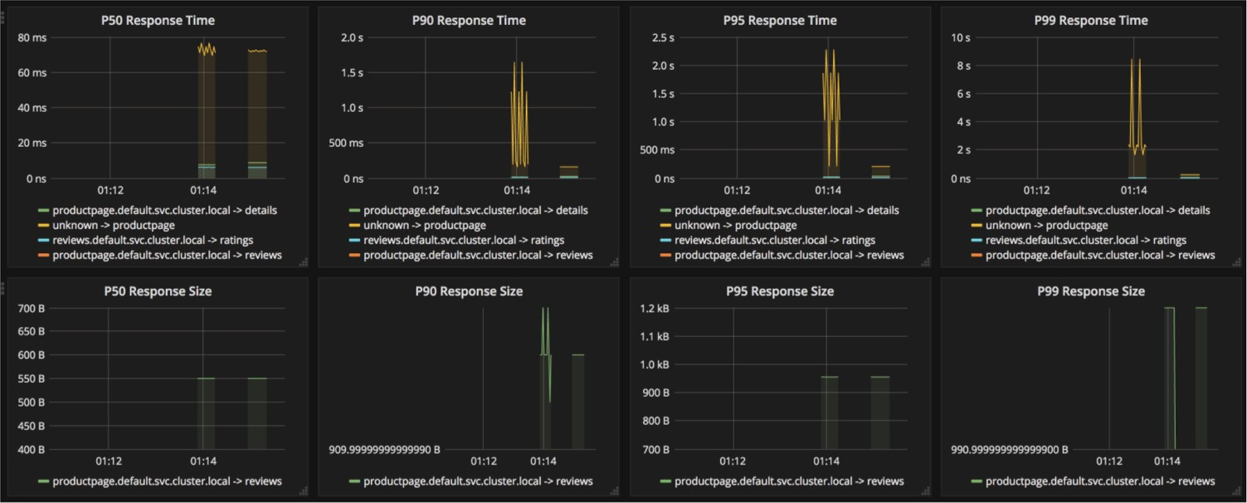
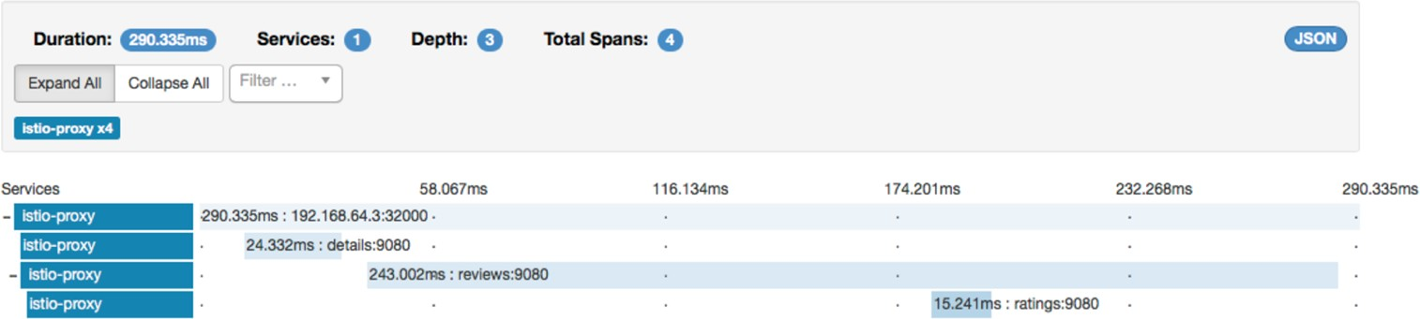
Visibility
Monitoring & tracing should not be an afterthought in the infrastructure
Goals
Metrics without instrumenting apps
Istio - Grafana dashboard w/ Prometheus backend
Consistent metrics across fleet
Trace flow of requests across services
Portable across metric backend providers
Istio Zipkin tracing dashboard

Slide 41
Metric Flow
Prometheu
 | InfluxDB
Custom
Prometheu s
InfluxDB
s
backend
Prometheu s
InfluxDB
Mixer collects metrics emitted by Envoys
Prometheus Adapter
InfluxDB Adapter
Custom Adapter
Adapters in the Mixer normalize and forward to monitoring backends
Mixer
API: /svcB Latency: 10ms Status Code: 503
Src: 10.0.0.1
Dst: 10.0.0.2
…...
Metrics backend can be swapped at runtime
Pod
Envoy
Envoy
svcA
svcB
Service A
Service B

Slide 42
Visibility : Tracing
 | Zipkin
 | Stackdriver
Custom
Prometheu s
InfluxDB
backend
Prometheu s
InfluxDB
Application do not have to deal with generating spans or correlating causality
Zipkin Adapter
Stackdriver Adapter
Custom Adapter
Mixer
Envoys generate spans
Applications need to *forward* context headers on outbound calls
Span
s
Span s
Envoys send traces to Mixer
Pod
Envoy
Envoy
Envoy
Trace Headers X-B3-TraceId X-B3-SpanId
X-B3-ParentSpanId X-B3-Sampled X-B3-Flags
Adapters at Mixer send traces to respective backends
svcA
svcB
svcC
Service A
Service B
Service C

Slide 43
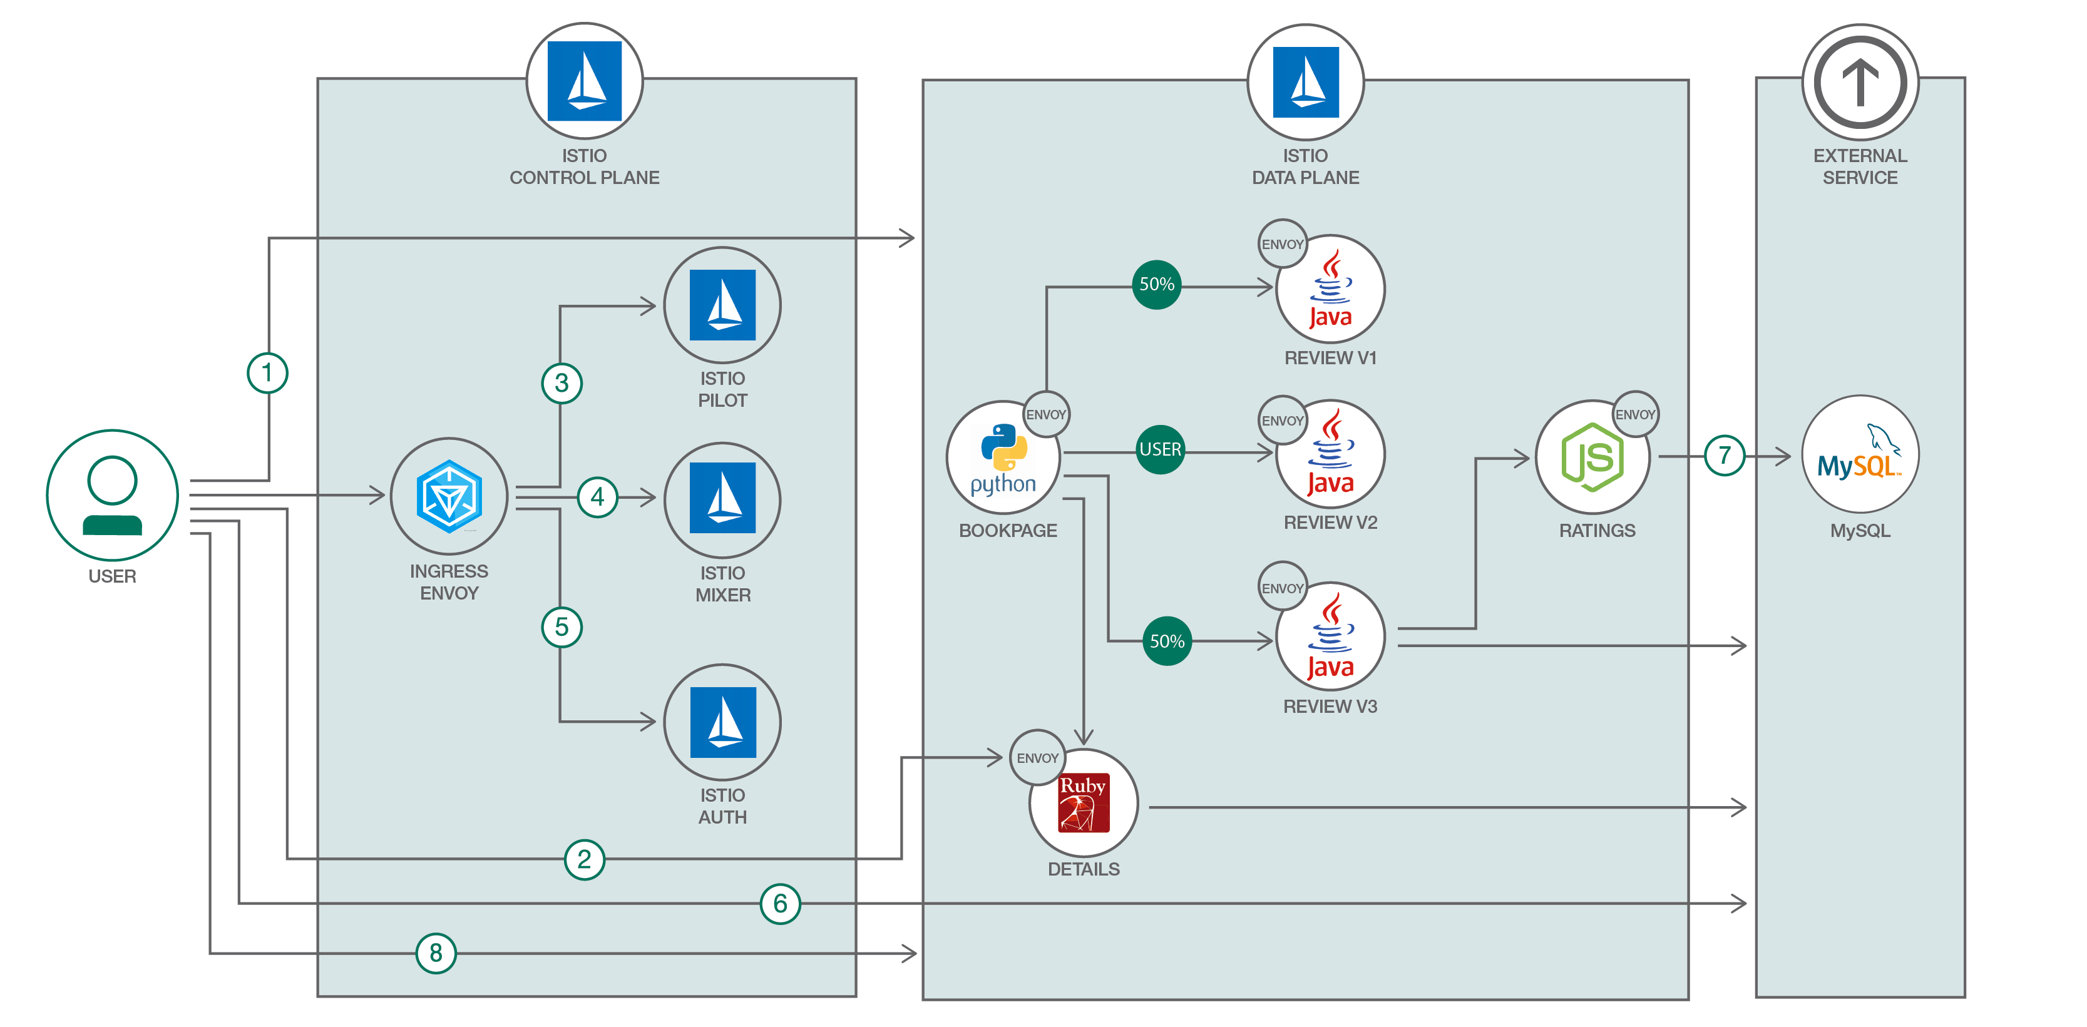
Developer Journey:
Manage micro services traﬃc using Istio on Kubernetes
Slide Title Goes Here
Microservices and containers have changed application design and deployment patterns. They have also introduced new challenges, such as service discovery, routing, failure handling, and visibility to microservices. Kubernetes can handle multiple container-based workloads, including microservices, but when it comes to more sophisticated features like traffic management, failure handling, and resiliency, a microservices mesh like Istio is required.
Developer Works Code: https://developer.ibm.com/code/journey/manage-microservices-traffic-using-istio/ Github: https://github.com/IBM/microservices-traffic-management-using-istio

Slide 44
































ISTIO CONTROL
ISTIO DATA
EXTERNAL SERVICE
PLANE
PLANE
SAMPLE BOOKINFO APP
1
ISTIO PILOT
ROUTING RULES
ENVOY
ENVOY
50%
REVIEWS-V1
3
ENVOY
ENVOY
REVIEWS-V2
6
ENVOY
4
MIXER
BOOK PAGE
USER
RATINGS
GRAPHANA
/ZIPKIN
7
ENVOY
5
REVIEWS-V3
50%
ISTIO AUTH
2
ENVOY
DETAILS
6
8

Slide 45

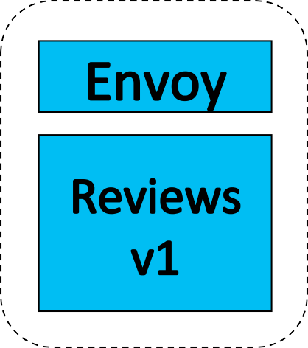


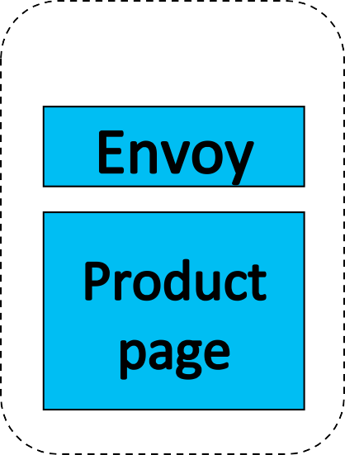
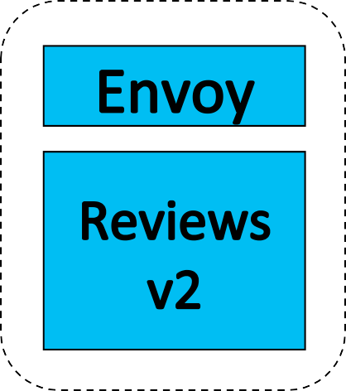
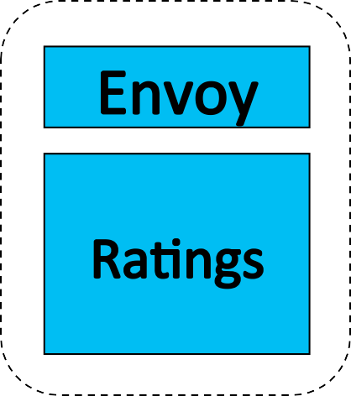
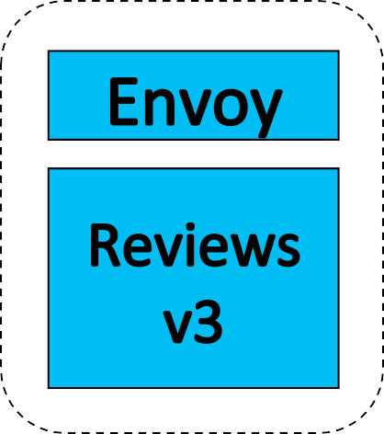

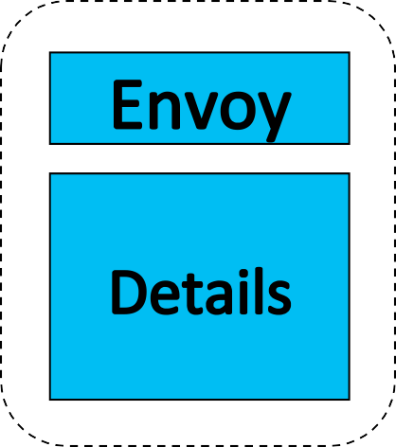
Part A
Pod

Slide 46
Traﬃc Route
Pod
50%
50%

Slide 47
Traﬃc Route
Pod
user = jason

Slide 48
Traﬃc Route
Pod
100%

Slide 49
Access Policy
Pod
100%

Slide 50








Part B
Pod

